Slide 1




Income Classify
Sri Jay Adarsh Gogineni
20025484
Muhammad Owais Imran
20025554
Aayush Aggarwal
20011332
Shreyas Desai
20022834
Unveiling Socio-Economic Thresholds

Slide 2
Objective:
Our project aims to use data mining and knowledge discovery techniques to classify people in one of the two salary brackets (<=50k and >50k), providing insights into fair play compensation practices.
By examining the importance of age, gender, ethnicity, and educational level, we aspire to highlight trends in compensation.

Slide 3
Problem
Fair Pay Analysis:
Income disparity across various demographics is a pervasive societal issue with far-reaching implications.
The way individuals are compensated can significantly impact their quality of life, access to resources, and opportunities for personal and professional growth.
Our aim is to delve into this complex landscape by developing a predictive model that analyzes a comprehensive dataset encompassing diverse demographic features.
The objective is to ascertain whether these features can serve as reliable predictors to determine if an individual is likely to earn above or below the 50k income threshold.
0 denotes the salary is <=50k
1 denotes the salary is >50k

Slide 4
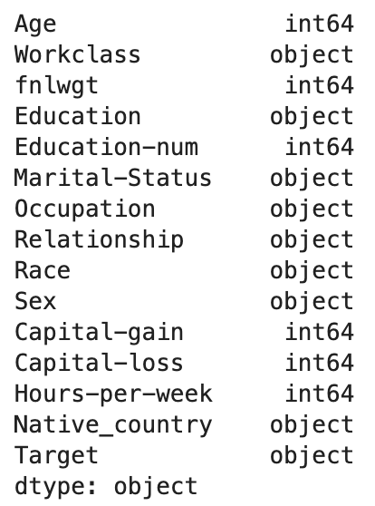
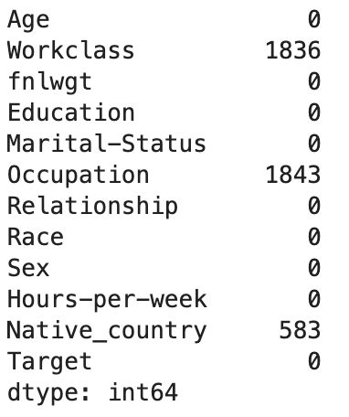
Dataset Description
Our dataset - Yes or NO 50K salary
14 features
32,561 observations
1800 Null Values
Contains both numerical and categorical variables
Target variable: Salary
Dataset Columns:
Null Values:

Slide 5
Dataset Description
Age:Represents the age of the individual.
Workclass:Specifies the employment category of the individual, such as private, government, or self-employed.
fnlwgt:Denotes the final weight, an adjustment to the sampling survey data for demographic estimation.
Education:Indicates the highest level of education attained by the individual.
Education-num:Corresponds to the numerical representation of education levels, providing an alternative encoding.
Marital-Status:Describes the marital status of the individual, including categories like married, single, divorced, etc.
Occupation:Identifies the type of occupation or job held by the individual.
Relationship:Specifies the role of the individual in the family or relationship context.
Source: Kaggle Dataset

Slide 6
Dataset Description
Race:Represents the racial background of the individual.
Sex:Indicates the gender of the individual, typically categorized as male or female.
Capital-gain:Refers to the capital gains, representing the profit from the sale of an asset.
Capital-loss:Represents the capital losses, indicating the financial loss from the sale of an asset.
Hours-per-week:Denotes the average number of hours worked per week by the individual.
Native_country:Specifies the country of origin or citizenship of the individual.
Target:Binary variable indicating the target variable, often representing income brackets (e.g., >50K or <=50K).
Source: Kaggle Dataset

Slide 7
Data Exploration
Various methodologies were employed to gain deeper insights into the dataset, facilitating a better understanding for subsequent steps in data visualization. Initially, we identified the unique values within our dataset, uncovering the presence of '?' in some features. To address this, we systematically replaced these '?' occurrences with NaN values.
Subsequently, we addressed the null values through two distinct approaches:
Approach 1: We opted to remove all instances with null values, streamlining the dataset by dropping these records.
Approach 2: For null values in certain features deemed to be Missing Completely at Random (MCAR), we pursued a strategy involving the replacement of missing values with either the mean, median, or mode of the respective features.
Finally, to prepare the data for further analysis, we performed label encoding and subsequently split the dataset. This comprehensive process ensures a cleaner and more structured dataset for subsequent stages of exploration and analysis

Slide 8
Data Exploration
Objective: Gain in-depth insights and prepare the dataset for analysis.
Identifying Unique and Null Values:
We began by identifying unique values in the dataset, revealing the presence of '?' in some features.
Handling '?' Occurrences: We systematically replaced '?' with NaN values to ensure data consistency.
Dealing with Null Values
Approach 1: Removing Null Values: We streamlined the dataset by removing instances with null values, ensuring data integrity.
Approach 2: Handling Missing Values: For certain features with Missing Completely at Random (MCAR) null values, we adopted a strategy of replacing them with the mean, median, or mode, maintaining data quality.
Data Preparation:
Label Encoding: To make the data suitable for analysis, we performed label encoding for categorical variables.
Dataset Splitting: We split the dataset into structured segments, ensuring a cleaner and more organized dataset for subsequent analysis.
Finally, to prepare the data for further analysis, we performed label encoding and subsequently split the dataset. This comprehensive process ensures a cleaner and more structured dataset for subsequent stages of exploration and analysis

Slide 9
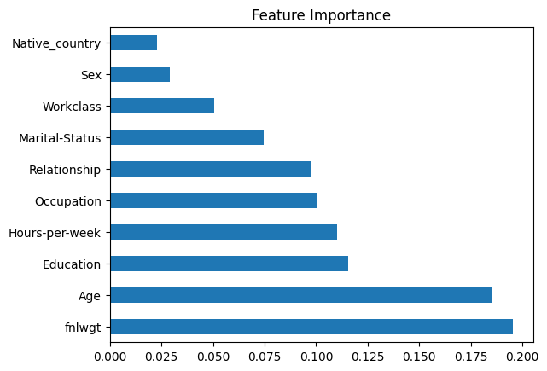
Data Visualization
We employed label encoding on our dataset and conducted an analysis to determine the feature importance of each variable, aiming to discern their relationship with the target variable. Based on the visual representation on the right, it is evident that age and fnlwgt exhibit the highest feature importance among all the features concerning the target variable.

Slide 10
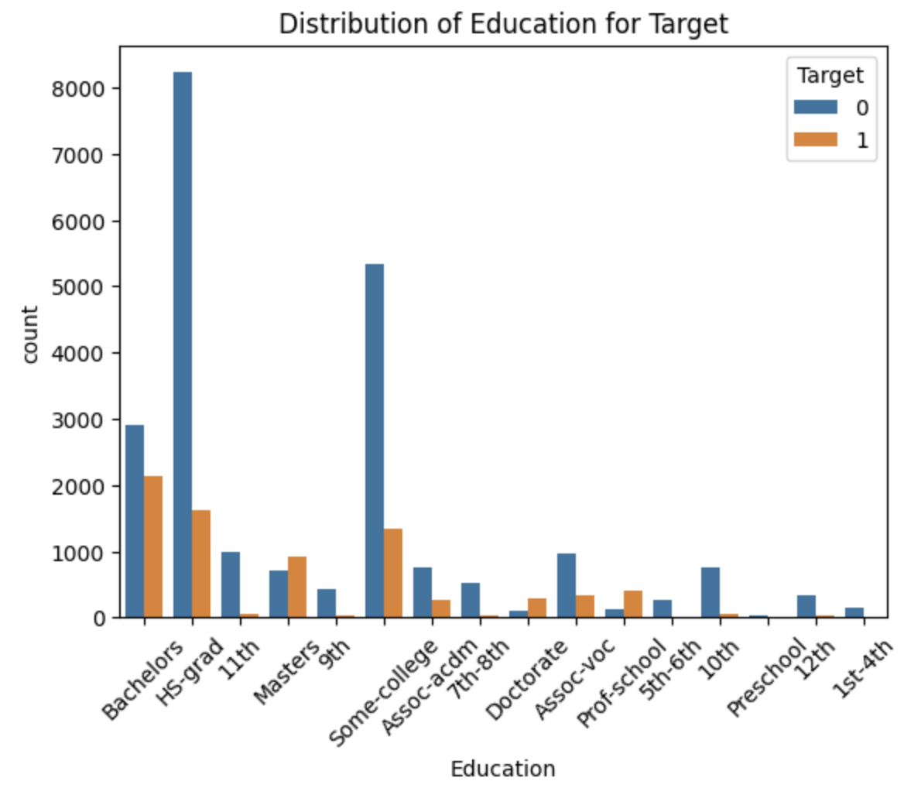
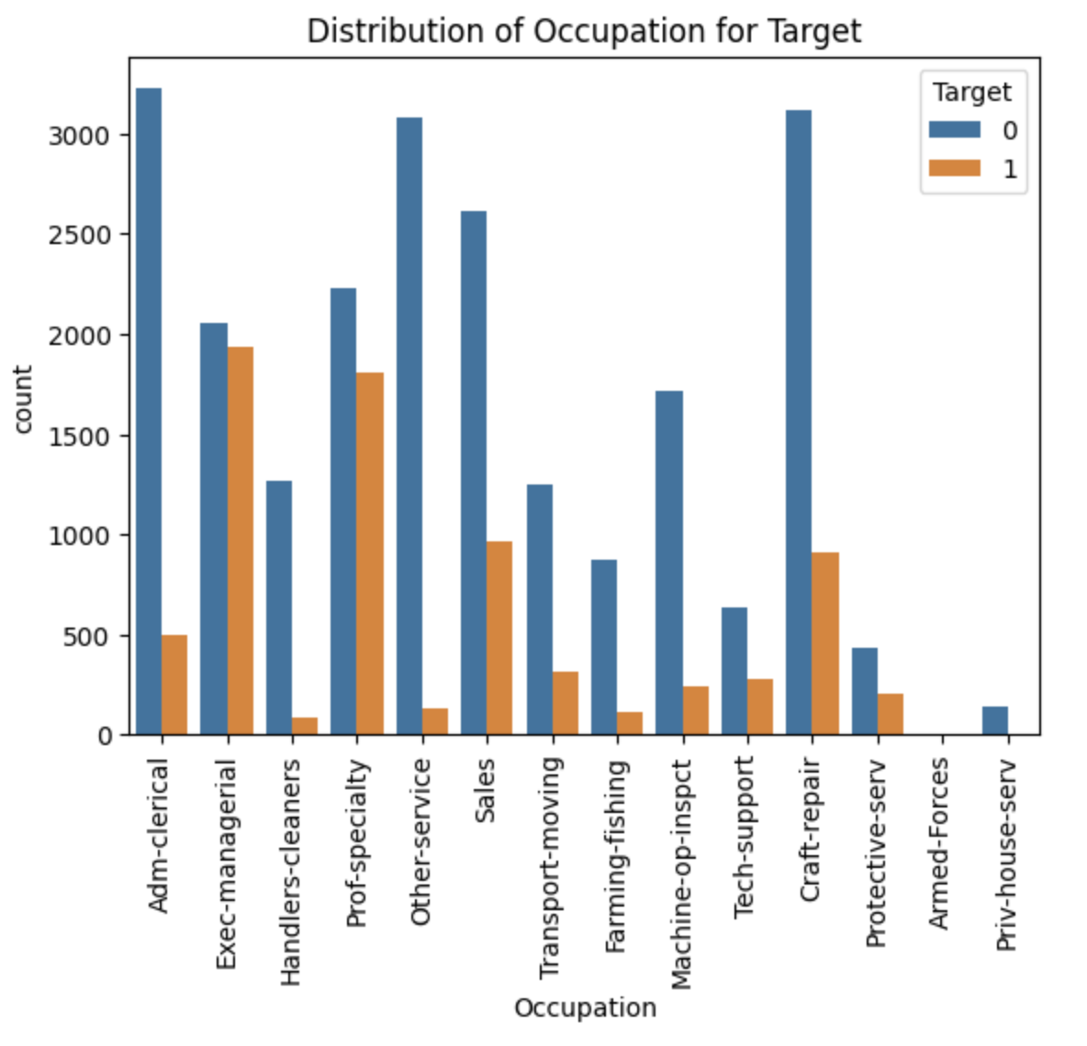
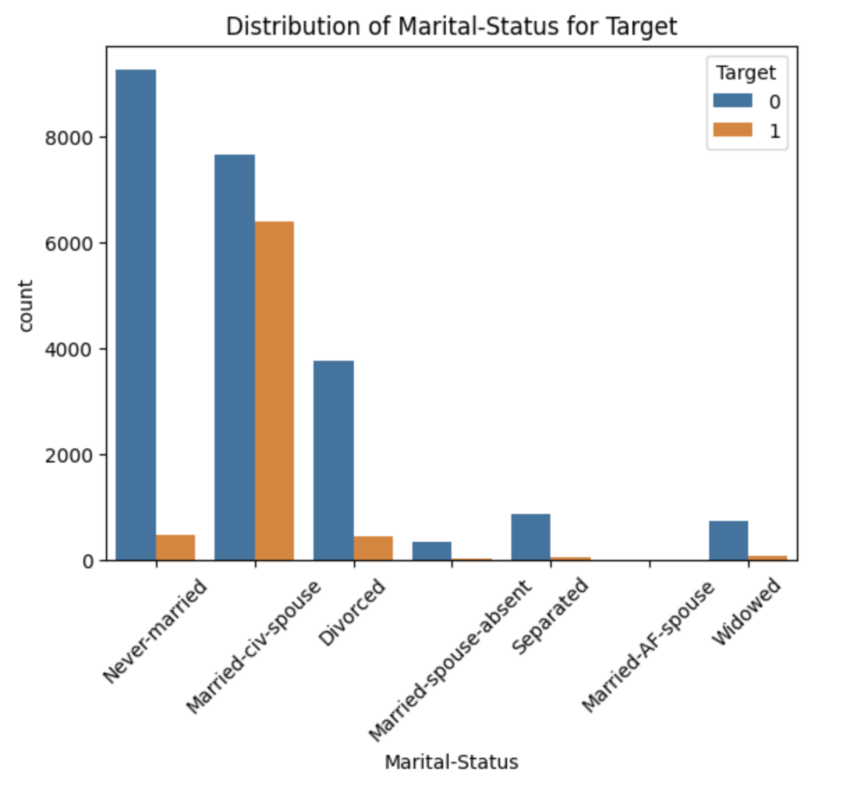
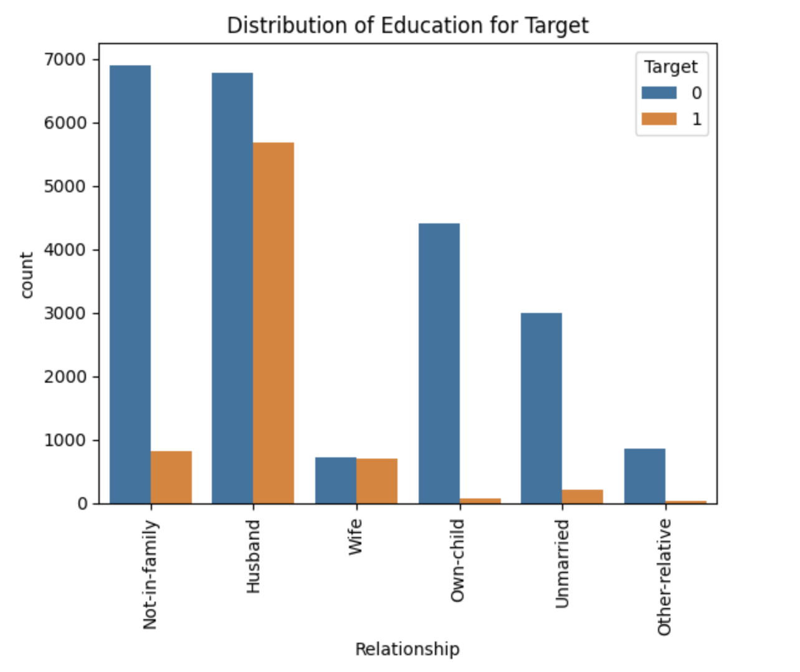
Distributions of Features by Target

Slide 11
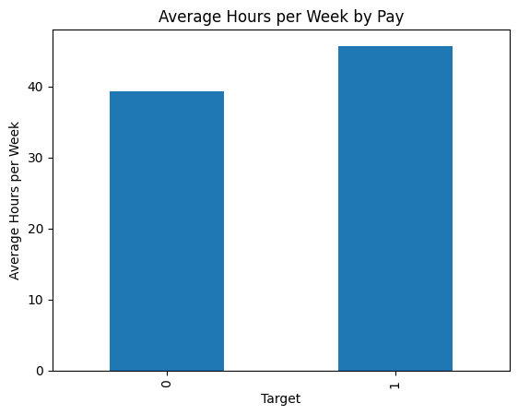
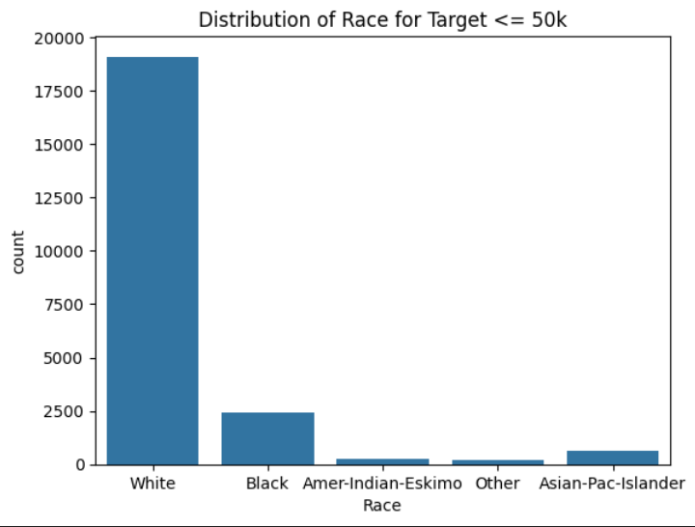
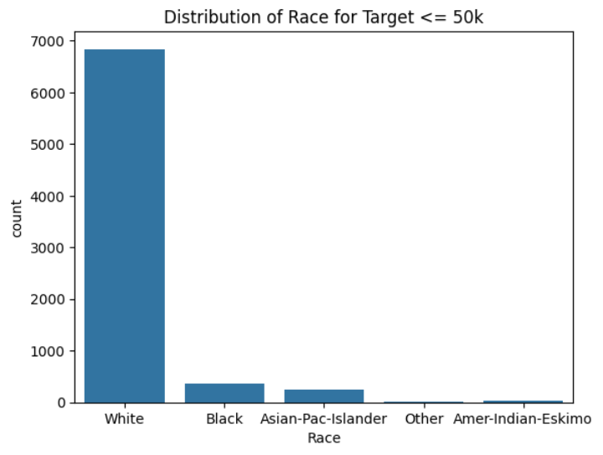

The race distribution is heavily skewed in this dataset and does not indicate the proportion of each racial group within the overall population
The total count in each racial group is lower in the >50k bracket suggesting a smaller proportion of the dataset is earning more than 50k regardless of race
Work Hour Consistency: Average hours worked per week by both income groups are similar, indicating number of hours worked is not drastically different between the groups
Income vs Work Hours: Slight increase in average hours per week could suggest more hours is associated with higher pay, but it might imply that higher income could be influenced by other factors such as job type, education level, or age

Slide 12
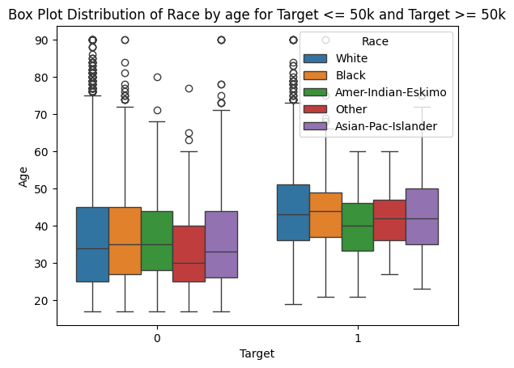
Age Distribution Across Races: The median ages within each racial category are similar regardless of income level, suggesting median age doesn't vary by race within each income bracket.
Income Effect on Age Distribution: For all race groups, individuals in the >50k income bracket tend to be older than those in the <=50k bracket suggesting that higher income is associated with older age across all racial groups.

Slide 13
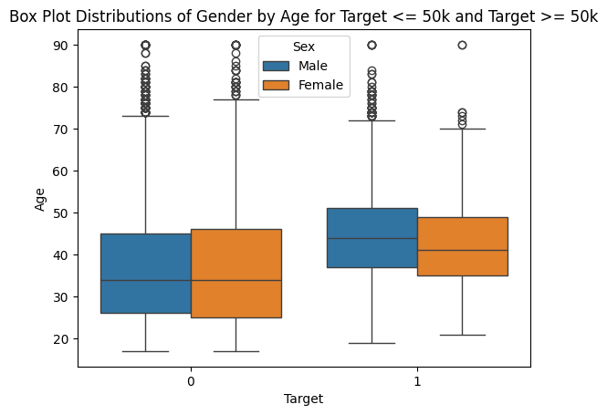
Age and Gender Distribution Across Income Brackets
Gender with Age Distribution: Both males and females who earn more (>= 50k) tend to be older than those who earn less
Similar age ranges for both genders indicate age distribution is gender neutral in relation to income
Higher earnings could be associated with older age
There are several outliers in both income categories for both genders, with particularly more outliers in the lower income category for males.

Slide 14
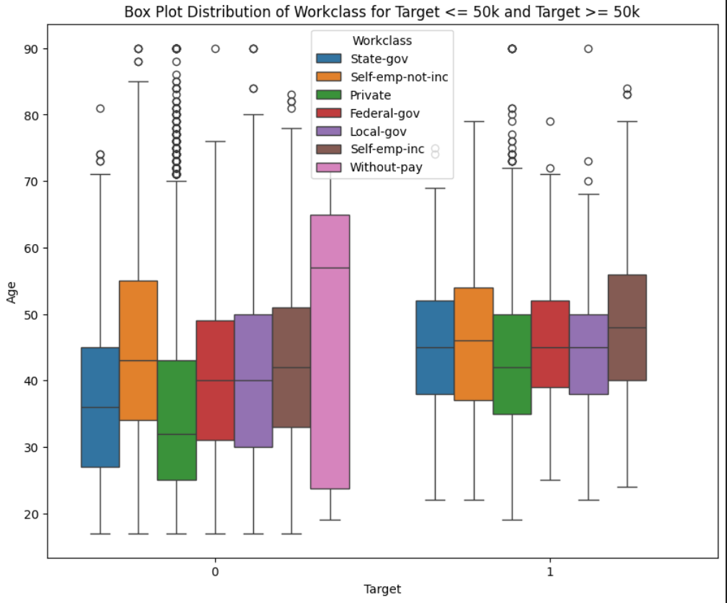
Age and Work Class in relation to Pay
Age and Income Relation: For most work classes, individuals in the >50k group tend to be older, which is consistent with the idea that older age might correlate with higher earnings.
Variation by Work Class: Each work class has a different median age, and the spread of ages varies significantly between classes. For example, 'Without-pay' in the <=50k group has a very high median age compared to others.
Outliers: There are outliers present in both income brackets across various work classes

Slide 15
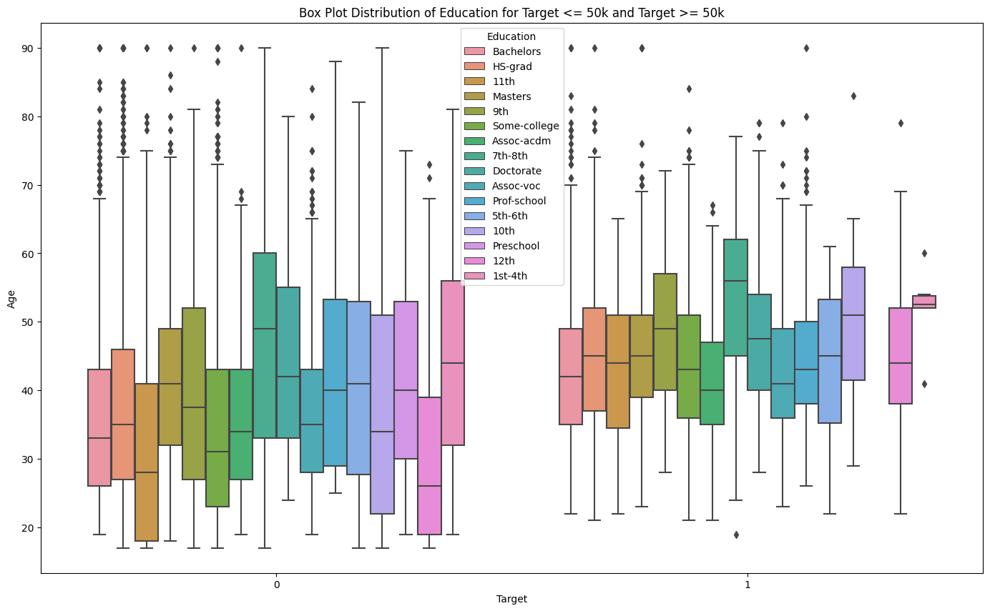
Age and Education in relation to Pay
Income and Education Correlation: Higher levels of education such as masters, doctorate, and professional school tend to have a higher age in the >50k income bracket, suggesting that advanced degrees may correlate with both higher age and income
Comparative Analysis: Comparing the two income brackets, the spread and median of ages in the >50k bracket are generally higher, which suggests that higher income is associated with older age across educational levels.
Age Range: The age range for individuals with a bachelor's degree or higher is broader in the >50k income bracket, which could imply that it takes time to reach this income level, even with higher education.

Slide 16
Approach 1 - Drop Missing Rows
The very basic approach we took was to drop all rows having any missing values.
32,561 total rows
2399 rows were dropped
This equates to dropping 7% of our dataset - may not have a significant impact

Slide 17
Model Training
The model was trained on four classification models, keeping KNN as benchmark
Scores | KNN (k=9) | Gaussian NB | Random Forest Classifier | XGBoost
Accuracy | 73% | 75% | 82% | 83%
Precision | 77% | 88% | 86% | 87%
Recall | 91% | 77% | 91% | 91%
F1-Score | 84% | 82% | 88% | 89%

Slide 18
KNN
Hyper Parameters:
Neighbours: 11
Weights: distance
Metrics: manhattan
Accuracy: 74.5%
Precision: 78%
Recall: 92%
F1-Score: 84%

Slide 19
Gaussian NB
Hyper Parameters:
Priors: None
Accuracy: 75.29%
Precision: 88%
Recall: 77%
F1-Score: 82%

Slide 20
Random Forest
Hyper Parameters:
n_estimators: 50
max_depth:10
Min_samples_split:5
Accuracy: 82.9%
Precision: 87%
Recall: 91%
F1-Score: 89%

Slide 21
XGBoost
Hyper Parameters:
learning_rate:0.1
n_estimators:50
max_depth:7
min_child_weight:3
gamma:0
Accuracy: 83%
Precision: 87%
Recall: 91%
F1-Score: 89%

Slide 22
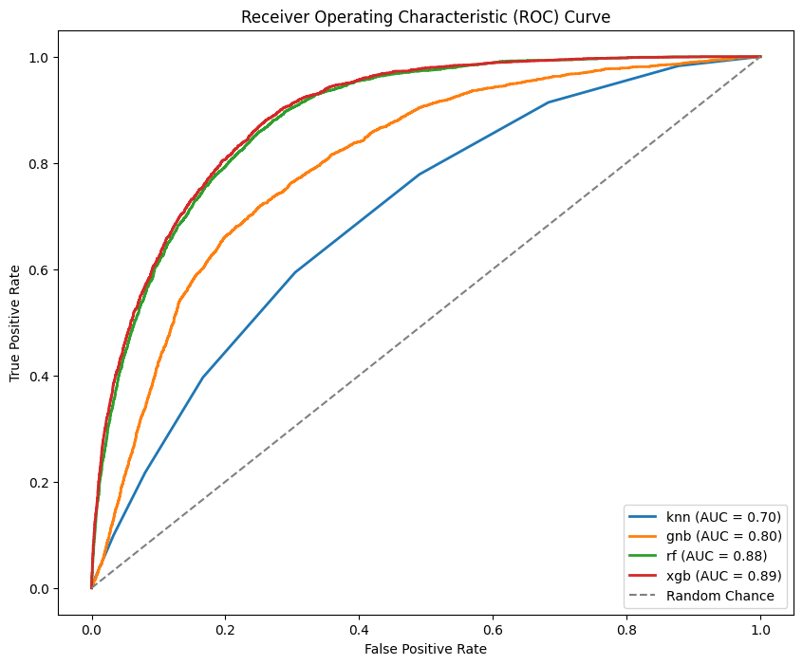
ROC Curve for 1st Approach

Slide 23
Approach 2 - Replace Null Values
Empty or null values in each column are replaced with the most occurring values (mode) in each column.
By imputing missing values, we hope to maximize the utility of our dataset, ensuring that no data point goes unused due to incomplete information

Slide 24
Model Training
The model was trained on four classification models, keeping KNN as benchmark
Scores | KNN (k=9) | Gaussian NB | Random Forest Classifier | XGBoost
Accuracy | 75.00% | 76.16% | 83.06% | 83.71%
Precision | 79% | 89% | 87% | 88%
Recall | 92% | 79% | 91% | 91%
F1-Score | 85% | 83% | 89% | 89%

Slide 25
Hyper parameter Tuning - Randomized Search
What is Randomized Search?
It helps find the best hyperparameters for machine learning models
Randomly samples combinations from a specified search space.
Advantages:
Efficient compared to exhaustive grid search.
Results: Improved model performance and reduced training time.

Slide 26
KNN
Hyper Parameters:
Neighbours: 9
Weights: distance
Metrics: manhattan
Accuracy: 75.53%
Precision: 80%
Recall: 90%
F1-score: 85%

Slide 27
Gaussian NB
Hyper Parameters:
Priors: None
Accuracy: 75.84%
Precision: 89%
Recall: 78%
F1-score: 83%

Slide 28
Random Forest
Hyper Parameters:
n_estimators: 50
max_depth:20
min_samples_split:10
Min_samples_leaf:4
Accuracy: 83.41%
Precision: 87%
Recall: 92%
F1-score: 89%

Slide 29
XGBoost
Hyper Parameters:
learning_rate:0.1
n_estimators:200
max_depth:3
min_child_weight:1
Gamma:0.2
Accuracy: 84.12%
Precision: 88%
Recall 92%
F1-score: 90%

Slide 30
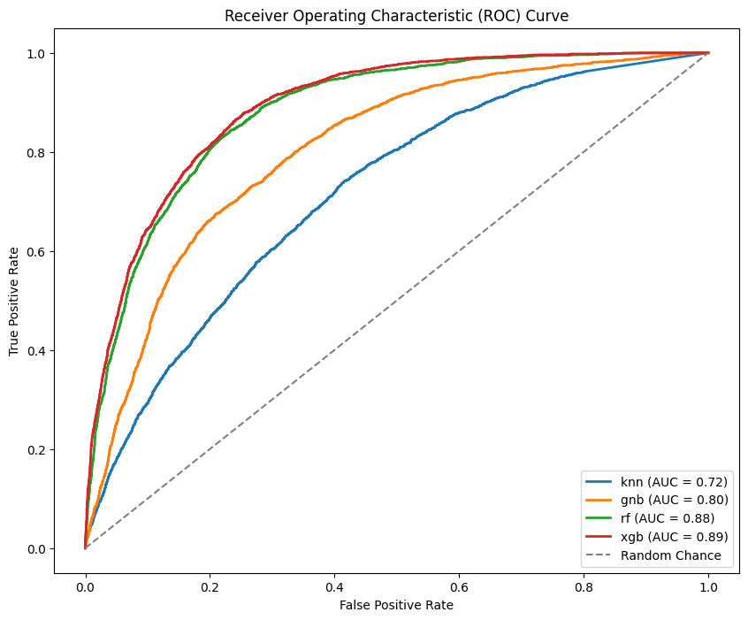
ROC Curve for 2nd Approach

Slide 31
TPOT (Tree-based Pipeline Optimization Tool) Validation
TPOT (Tree-based Pipeline Optimization Tool) serves as an AutoML (Automated Machine Learning) solution designed to automate the model selection and hyperparameter tuning process.
TPOT's AutoML capabilities provide a convenient and efficient alternative to manual hyperparameter tuning, demonstrating comparable performance metrics and scalability across the dataset.
Notes:
I want to say this

Slide 32
Analysis
XGBoost model has the best recall score and great accuracy as well.
Comparing it with other models on the basis of recall
on par with KNN and Random Forest.
While the gaussian Naive bayes model gives the lowest recall and average accuracy, it has the highest precision.
The F1-score is the highest for Xgboost model.

Slide 33
Conclusion
Key Insights from dataset:
Age and Income Correlation: Higher income brackets associated with older age groups, suggests experience and career longevity are valuable for higher earnings.
Educational Impact: Advanced degrees often correspond with the >50k salary bracket, suggests importance of education for career advancement and income potential.
Working more than 40 hours per week seems to have slight to no significant correlation with earnings
The age distribution of genders is similar, suggesting that age correlates with higher earnings, however more analysis has to be done for gender gap
Modeling Success:
Our predictive analysis has accurately classified individuals into their respective salary brackets with a best accuracy of 83.71%, leveraging the identified features to classify compensation

Slide 34
Future Additions
Further Gender Analysis: Investigate the gender gap in earnings more comprehensively. Explore factors contributing to any disparities.
Additional Data Sources: Consider incorporating external data sources to enrich the analysis and provide deeper insights.
Reduce Bias of the sample size of population

